Slide 1
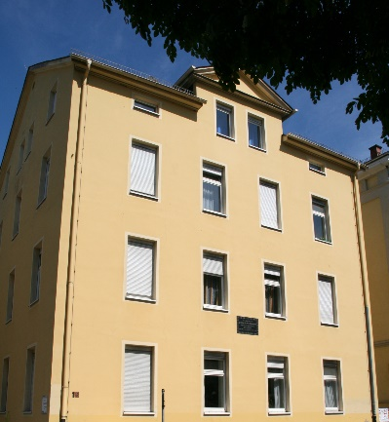
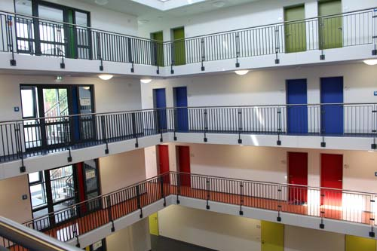
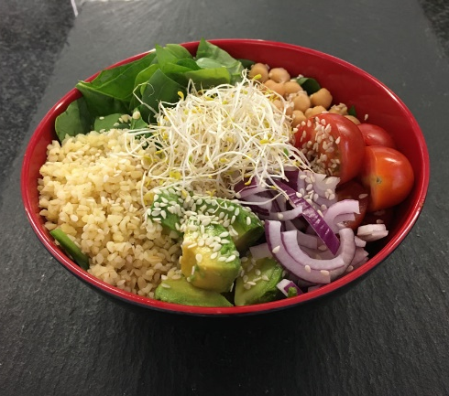
Your Time at „Studentenwerk Giessen“

Slide 2
Studentenwerk Giessen
Accommodation
Counselling
Financing
Food

Slide 3
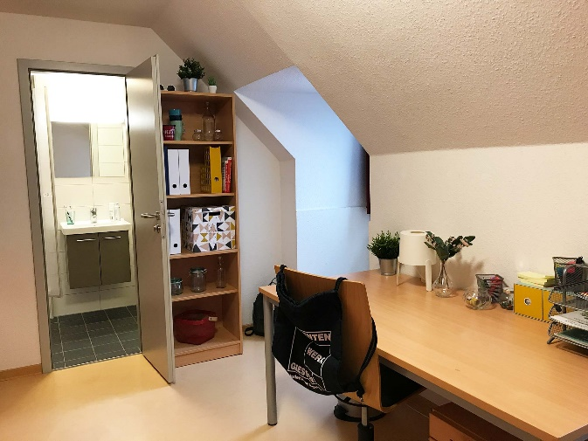
Accommodation
good2know:
we rent 2.650 rooms and apartments in ten residence halls in Giessen
all rooms and apartments are rented completely furnished at student-friendly prices
you can choose between different types of housing – living alone or living in a flat together with others and share bathroom and kitchen

Slide 4
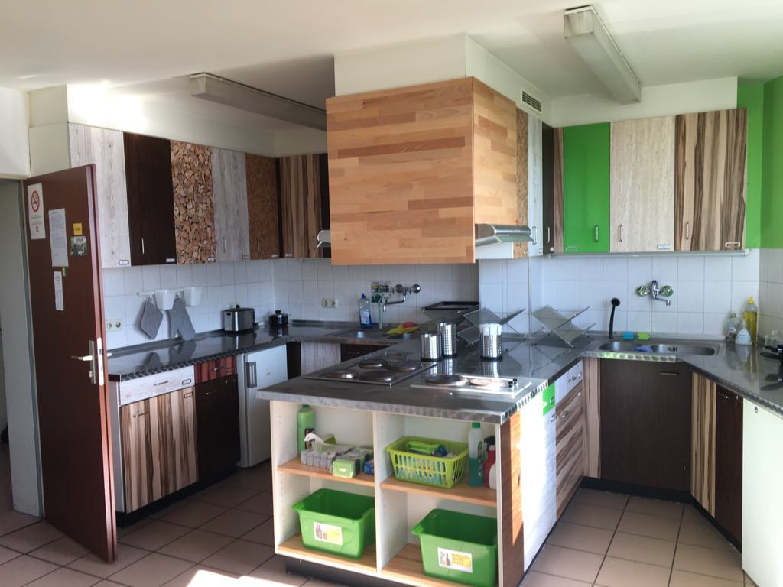
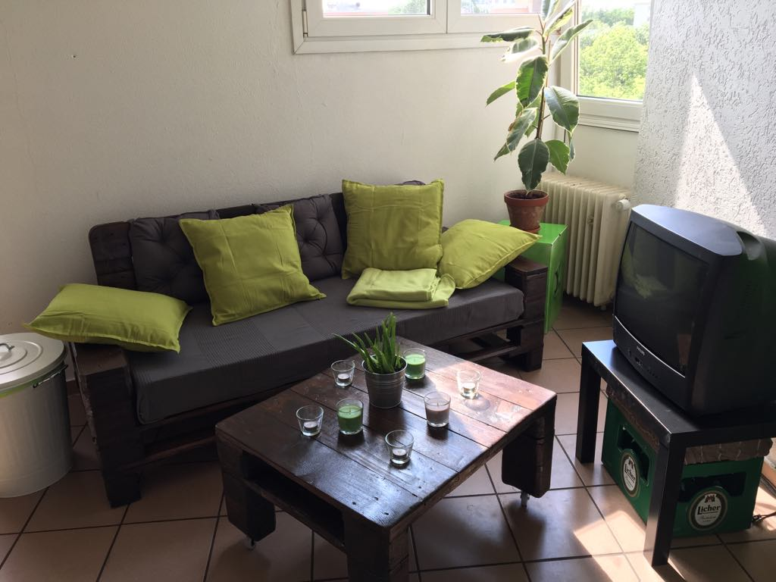
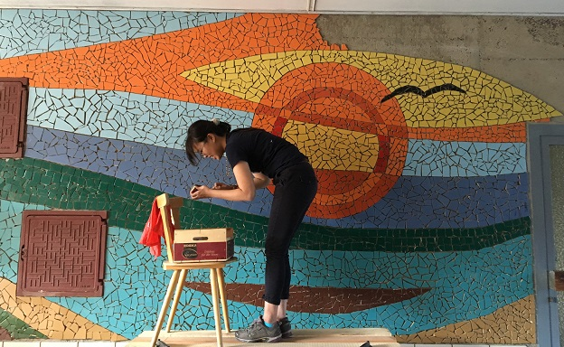
Accommodation
good2know:
if you are interested in renting a room, you have to apply for it
you can do that online on our website: www.studentenwerk-giessen.de/wohnen

Slide 5
Financing | Counselling
good2know:
our Advice & Service department will answer your questions about the financial support options available to you as part of their free and of course confidential advice
main department for international students!
you can get in touch with us by phone or email – in addition to that your are welcome to make an appointment if you want to meet us face-to-face or to use a video call: www.studentenwerk-giessen.de/beratung

Slide 6
Counselling | Family Service Center
good2know:
we take care of young families and have very good offers for students with children: for example, we run two kindergartens and students' children can have meal for free in one of our canteens
for helpful advice regarding studying with children please visit: www.studying-with-children.de/index.html

Slide 7
Food
good2know:
if you are looking for tasty food, which comes for a good price for students, the best place to go is one of our canteens – called “Mensa”
you can choose between vegan and vegetarian meals, but our chefs also come up with delicious dishes for meat and fish fans
there are several other canteens located in different campus areas which are called “Cafeteria”, “Kaffeebar” or “FreiRäume”, where you can have a break, meet other students, work or just hang out
for more information please visit: www.studentenwerk-giessen.de/essen-trinken

Slide 8
+++ Follow us +++
www.instagram.com/stwgiessen www.facebook.com/Studentenwerk.Giessen https://twitter.com/StwGiessen www.youtube.com/channel/UCKo1C1GCQawQmQJ1Il3xaPw

